Slide 1

Working Airside:
Are your clients exposed?

Slide 2
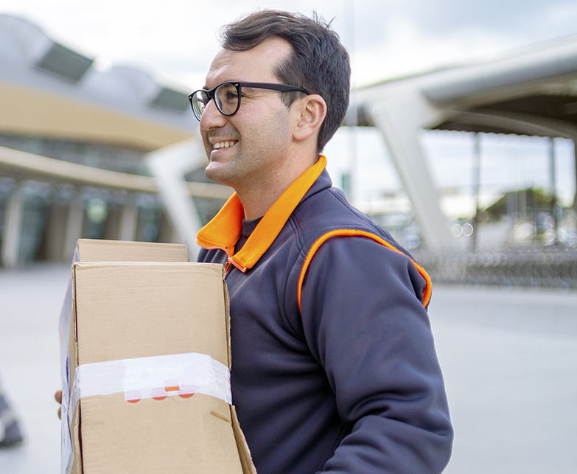
1. Do any clients visit airports?
Do you know if any of your clients have ever been asked to:
Perform regular work at an airport?
Perform a one-off task at an airport?
Deliver anything to an airport?
If the answer to a, b or c might ever be “yes”, then we suggest you keep reading! You might be surprised just how many companies can operate at an airport.

Slide 3
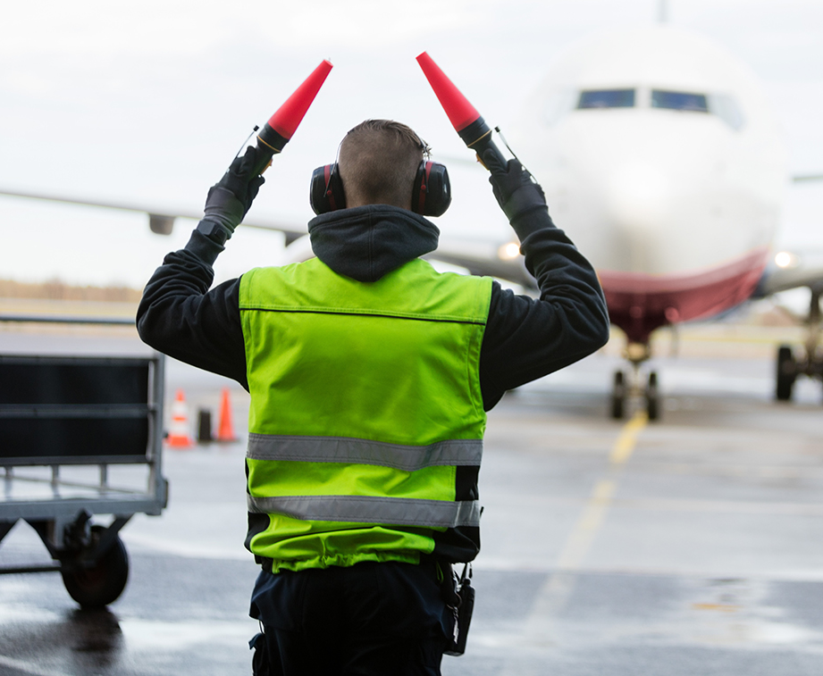
2. What if a client went today?
Do you know if your clients’ current public liability and motor insurance policies cover exposures at airports?
I’m certain there would be coverage.
I’m certain their wouldn’t be coverage.
I’m just not sure.
In our experience the answer is almost certainly b – there is no cover. So it may be worth asking your clients if they could ever work at an airport.

Slide 4
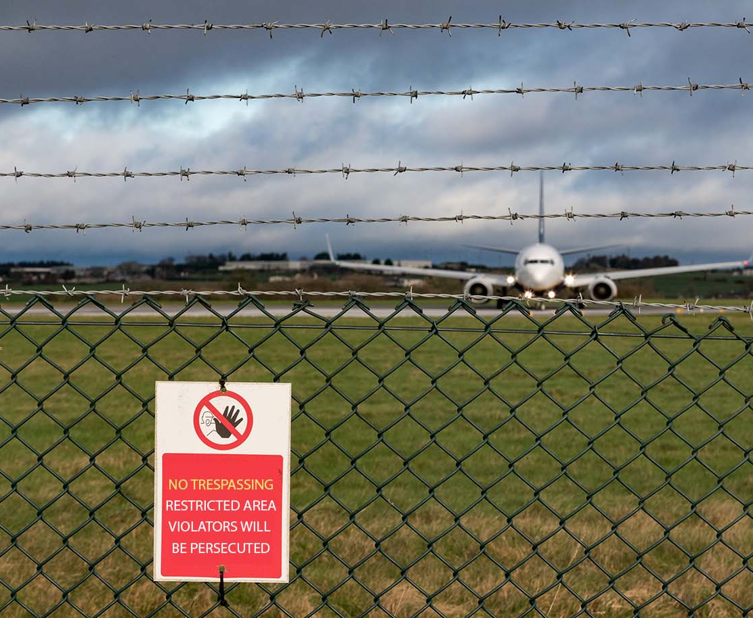
3. Is there restricted area access?
If you have a client that could ever work at an airport, where might they be working?
Only in areas open to the general public.
Through the security gates and inside the perimeter fence.
Within restricted access areas of the airport, including within a terminal or hangar.
If the answer is b or c then they will almost certainly need to obtain specific coverage to cover their liability.
Marsh Specialty’s Airside Liability insurance programme exists solely to cover these situations.

Slide 5
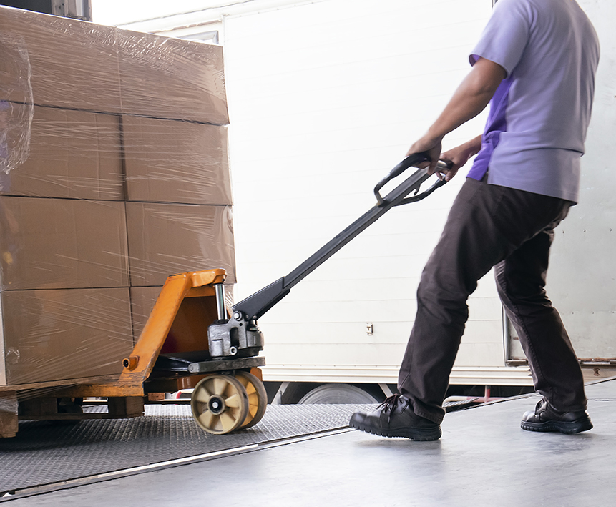
4. What scenarios do we cover?
Which of these examples of claims on an airport do you think would be covered under Marsh Specialty’s Airside Liability insurance programme?
A delivery driver reverses into the tail section of an aircraft.
A roofing contractor causes a fire in the ceiling cavity of a hangar.
A plumber causes flood damage to a terminal building.
a, b and c are all covered.
We cover your client when they are in any restricted area of an airport, including aprons, taxiways, areas beyond passport control, and all other buildings that are not accessible to the general public.

Slide 6
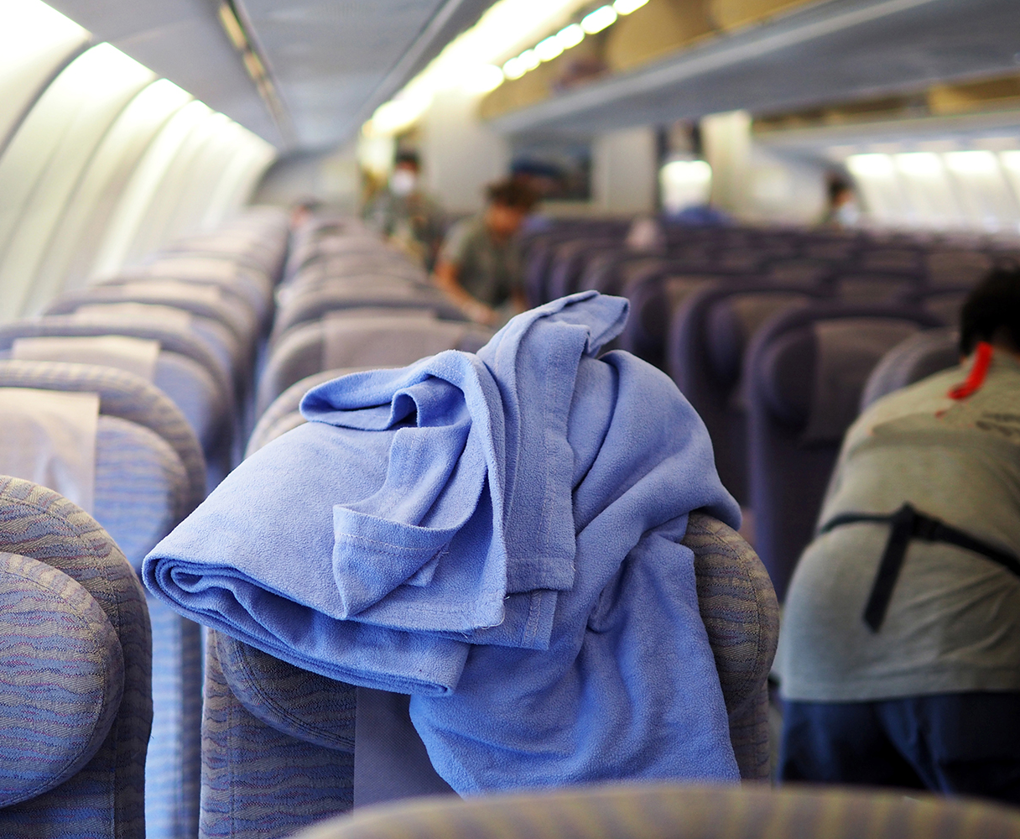
5. What scenarios do we cover?
Which of these other examples of airport claims do you think would be covered under Marsh Specialty’s Airside Liability insurance programme?
A gas worker causes a gas main rupture while cabling.
A shop sign falls down and hits someone on the head.
A waste removal truck hits a stationary ramp vehicle.
A cleaner damages an aircraft during a routine cleaning.
a, b, c and d are all covered.
Marsh Specialty can provide third party liability limits from GBP 5 million to GBP 100 million extending to worldwide coverage, if required (excluding US, Canada, and countries subject to sanctions).

Slide 7
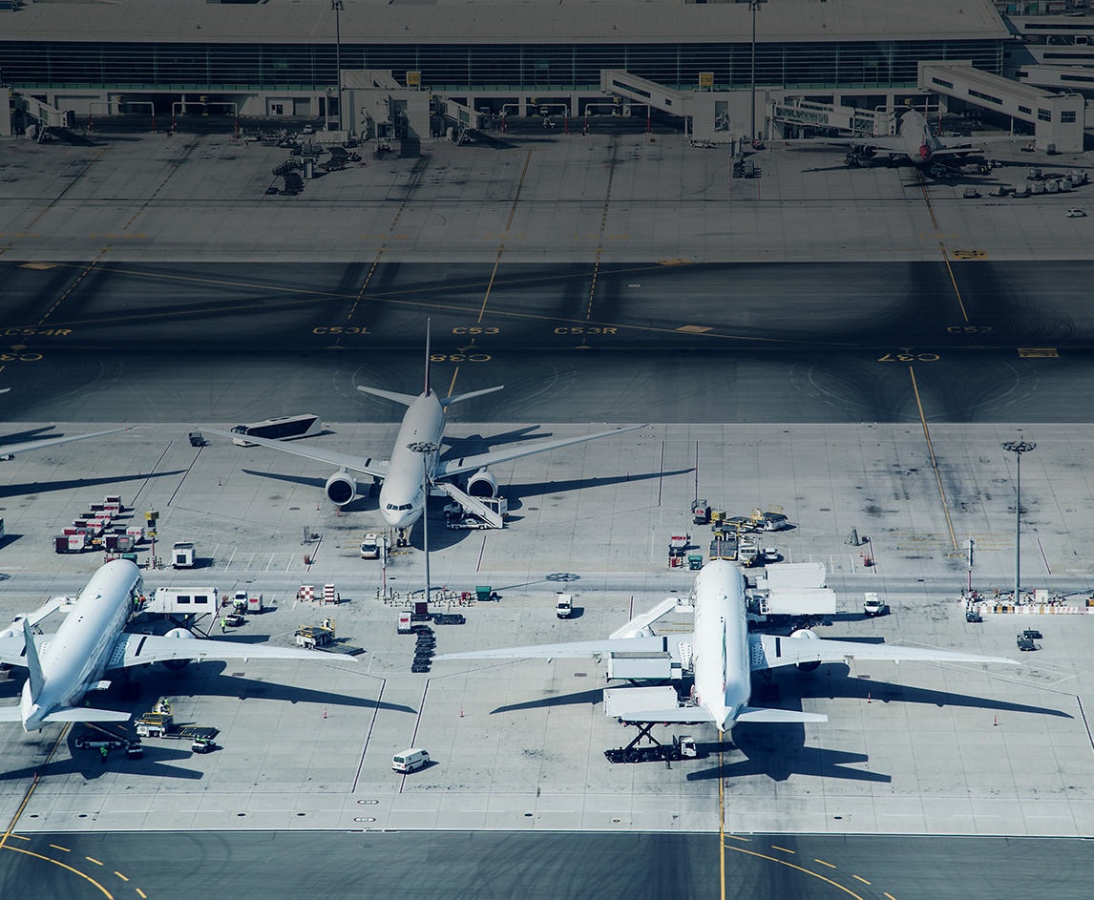
6. How long does coverage last?
What do you think might be the duration of a policy under Marsh Specialty’s Airside Liability insurance programme?
Marsh offers a full annual policy.
We offer cover for as little as a one-day.
We offer cover for any number of days between
1 and 365.
a, b and c are all correct.
In this way, Marsh Specialty can provide maximum flexibility to suit your clients’ needs and limit the amount they have to spend.

Slide 8
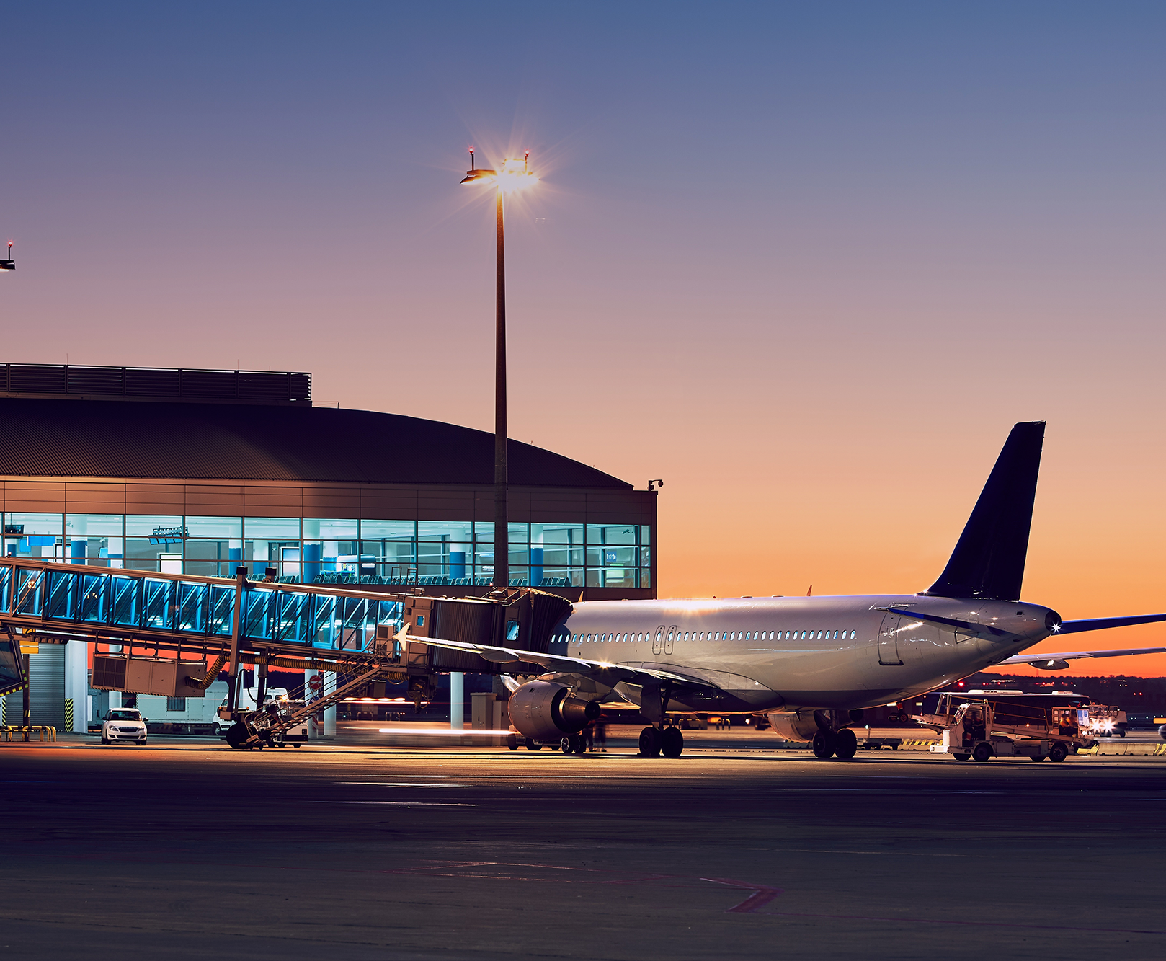
7. How easy is it to get a quote?
Once you’ve provided Marsh Specialty with an easy-to-complete questionnaire, how quickly do you think we commit to provide you with a formal written insurance quote?
5 working days.
3 working days.
1 working day.
The correct answer is c.
As soon as you provide us with all the necessary details we need, we commit to turn around a formal written insurance quote within just 1 working day.

Slide 9

8. Why choose Marsh Specialty?
Why should your clients choose Marsh to insure their airside liability exposures?
Marsh Specialty’s Airside Liability insurance programme is the largest programme of its kind in the UK, based on feedback received from underwriters and our own research.
Every year Marsh Specialty’s dedicated Airside Liability team handles 2,000 quotes and sells 1,000 policies.
We believe our ability to negotiate competitive rates is a key reason our bespoke third party insurance programme for contractors and concessionaires has been around for over 35 years!
Correct Answer: a, b and c.

Slide 10
Working Airside: Are your clients exposed?
Marsh Specialty’s Airside Liability Insurance Programme offers a solution.
If you have any questions or would like a formal quote, please contact one of our Airside Liability Team:
Jane Syrett | Alison Stennett | Laura Marie Glover
Vice President +44 (0)16 0320 7248 jane.t.syrett@marsh.com Marie Goffin Client Executive +44 (0)7385 517 384 marie.goffin@marsh.com | Assistant Vice President +44 (0)16 0320 7229 alison.m.stennett@marsh.com | Client Executive +44 (0)7385 404 124 laura-marie.glover@marsh.com

Slide 11
Marsh Specialty is a trading name of Marsh Ltd. Marsh Ltd is authorised and regulated by the Financial Conduct Authority for General Insurance Distribution and Credit Broking (Firm Reference No. 307511).
Copyright © 2021 Marsh Ltd. All rights reserved 794911198

